Slide 1
Introduction to Learning
Dr. Umberto Michelucci
umberto.michelucci@toelt.ai
© Dr. Umberto Michelucci - umberto.michelucci@toelt.ai

Slide 2
Terminology
© Dr. Umberto Michelucci - umberto.michelucci@toelt.ai
“The limits of my language mean the limits of my world.”
— Ludwig Wittgenstein.

Slide 3
Supervised machine learning
“Training a model from features and their corresponding labels. Supervised machine learning is analogous to learning a subject by studying a set of questions and their corresponding answers. After mastering the mapping between questions and answers, a student can then provide answers to new (never-before-seen) questions on the same topic.”
© Dr. Umberto Michelucci - umberto.michelucci@toelt.ai
https://developers.google.com/machine-learning/glossary#supervised_machine_learning

Slide 4
Unsupervised machine learning
“Training a model to find patterns in a dataset, typically an unlabeled dataset.
The most common use of unsupervised machine learning is to cluster data into groups of similar examples. For example, an unsupervised machine learning algorithm can cluster songs based on various properties of the music. The resulting clusters can become an input to other machine learning algorithms (for example, to a music recommendation service). Clustering can help when useful labels are scarce or absent. For example, in domains such as anti-abuse and fraud, clusters can help humans better understand the data.”
© Dr. Umberto Michelucci - umberto.michelucci@toelt.ai
https://developers.google.com/machine-learning/glossary#unsupervised_machine_learning

Slide 5
Semi-supervised machine learning
“Semi-supervised learning falls between unsupervised learning (without any labeled training data) and supervised learning (with completely labeled training data). Some of the training examples are missing training labels, yet many machine-learning researchers have found that unlabeled data, when used in conjunction with a small amount of labeled data, can produce a considerable improvement in learning accuracy.”
© Dr. Umberto Michelucci - umberto.michelucci@toelt.ai
https://en.wikipedia.org/wiki/Machine_learning

Slide 6
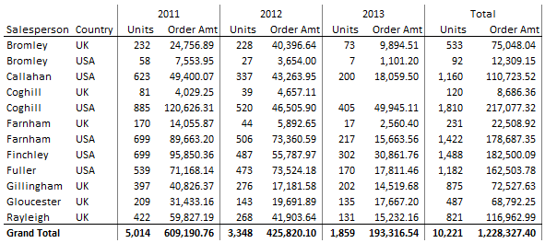
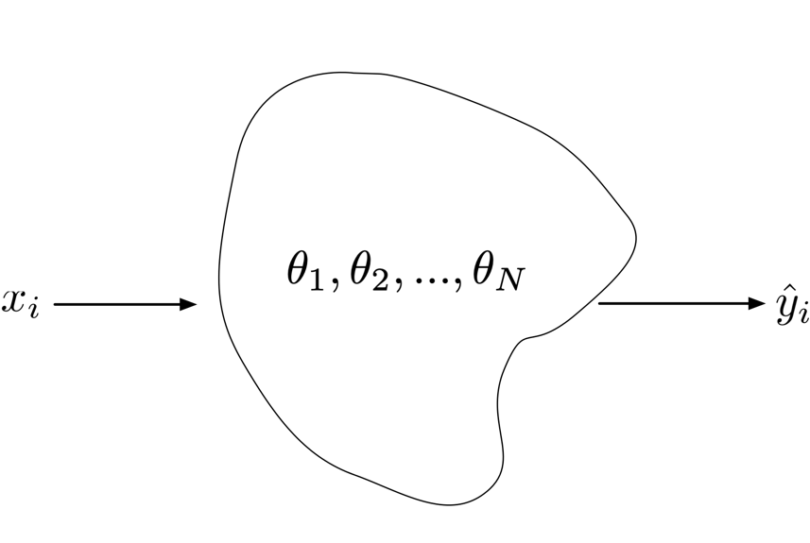
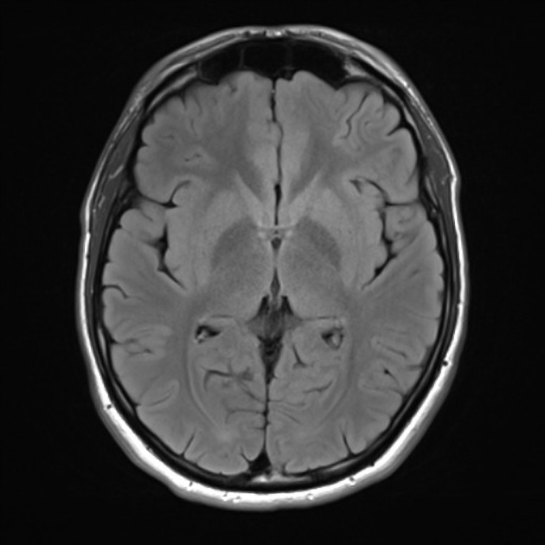
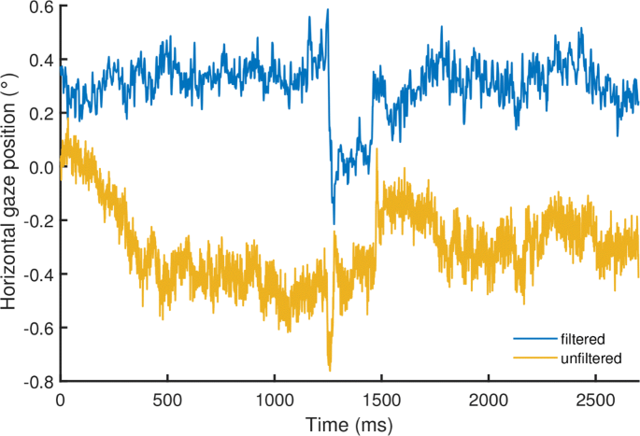
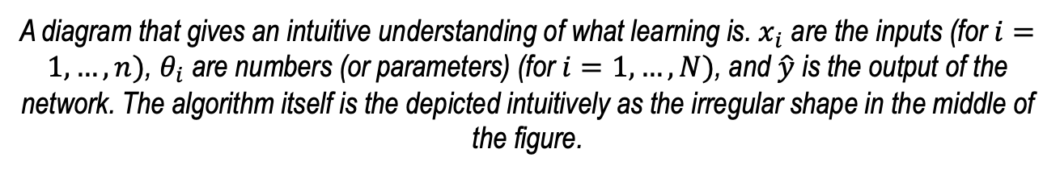
An intuitive understanding of learning
Class 1,
Class 2,
Class 3,
Etc.
Outputs
1.73
© Dr. Umberto Michelucci - umberto.michelucci@toelt.ai
Inputs
A diagram that gives an intuitive understanding of what learning is. $x_{i}$ are the inputs (for $i=1,…,n)$, $θ_{i}$ are numbers (or parameters) (for $i=1,…,N)$, and $\hat{y}$ is the output of the network. The algorithm itself is the depicted intuitively as the irregular shape in the middle of the figure.

Slide 7
An intuitive definition of learning
An algorithm that learns is typically nothing else than a mathematical function that depends on a set of parameters that are tuned, hopefully in some smart way, to make the algorithm output as close as possible to some expected output.
© Dr. Umberto Michelucci - umberto.michelucci@toelt.ai
Algorithm Type
Optimiser
Loss Function
U. Michelucci, Applied Deep Learning with TensorFlow 2, Springer Nature, 2022

Slide 8
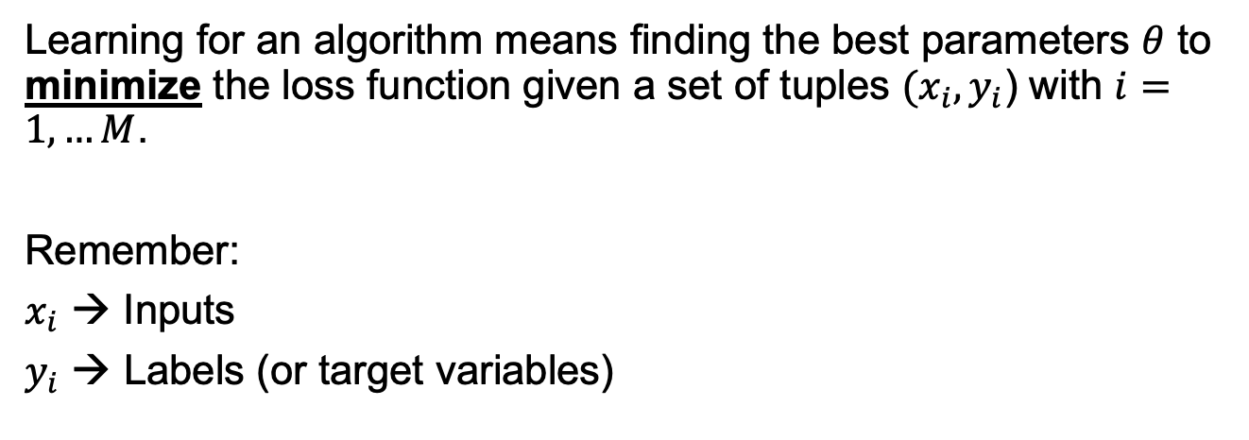
Learning
Learning for an algorithm means finding the best parameters $θ$ to minimize the loss function given a set of tuples $(x_{i}, y_{i}$) with $i=1,…M$.
Remember:
$x_{i}$ → Inputs
$y_{i}$ → Labels (or target variables)
© Dr. Umberto Michelucci - umberto.michelucci@toelt.ai
A mathematical formula
to measure “closeness”

Slide 9
Example of learning
© Dr. Umberto Michelucci - umberto.michelucci@toelt.ai
Image © Towarddatascience

Slide 10
Learning is in its most fundamental form an optimisation problem
© Dr. Umberto Michelucci - umberto.michelucci@toelt.ai

Slide 11
Optimisation in Mathematics
Optimization involves finding the maximum or minimum value of a function within its domain. It often deals with determining the best allocation of resources under given constraints. Examples include minimizing cost, maximizing efficiency, or finding the best fit of a model to data.
© Dr. Umberto Michelucci - umberto.michelucci@toelt.ai

Slide 12
Optimisation in Machine Learning
Optimization is the process of adjusting a model's parameters to minimize the difference between the predicted output and the actual output (i.e., the error)*. This is typically done through iterative methods like gradient descent (more on that later). The goal is to improve the model's performance on a given task, such as classification or regression, by minimizing a loss function.
* In supervised learning.
© Dr. Umberto Michelucci - umberto.michelucci@toelt.ai

Slide 13
Classification and Regression
Classification: the task of assigning a class (i.e. a color, a type of plant, etc.) to an object (image, data record, etc.)
Regression: the task of predicting a continous variable (i.e. humidity percent, etc.)
© Dr. Umberto Michelucci - umberto.michelucci@toelt.ai

